Slide 2
Exercise
Identify 5 sources of stress in your life currently.
Define and give realistic examples of stressor, i.e., extra-organizational, organizational, group, or individual. Then develop coping strategies that could be used to effectively manage these stressor.
Discuss the types of programs you would look for in your organization that would be able to help you manage those 5 sources of stress.
Notes:
Divide the class into eight groups. Have each group define and give realistic examples of their assigned stressor, i.e., extraorganizational, organizational, group, or individual. Then have each group develop a coping strategy that could be used to effectively manage this stressor.

Slide 3


Learning Objectives
Understand stress and its symptoms.
Identify personal and organizational stress/stressors.
Identify specific problems and find out the underlying causes.
Do away with the cause of stress and so that one is able to manage the stress effectively. Proactive vs. Reactive ways to deal with stress.

Slide 4
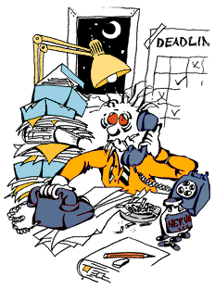
# Are you over scheduled?
# Are you unable to say no?
# Are you a Perfectionist?
# Do you hate to wait?
# Are you a constant worrier?
# Do you worry what people will think?
# Do you rerun conversations in your head?
# Do you find it difficult to take time for yourself?
# Do you have too many roles, too many responsibilities, too many choices, not enough preparation, not enough support?
THINK !

Slide 5

A Challenge
Please Tell a One Sentence Definition of
S T R E S S.

Slide 6
Stress
S = Sedentary Life Style
T = Time Mismanagement
R = Reactive Emotions
E = Errors in Self Management
S = Sleep Starvation
S = Spiritual Isolation

Slide 7

WHAT IS STRESS?
“Our response to any situation we find challenging, frightening, or difficult”
“Stress refers to events in which environmental or internal demands (or both) tax or exceed the adaptive resources of an individual”

Slide 8
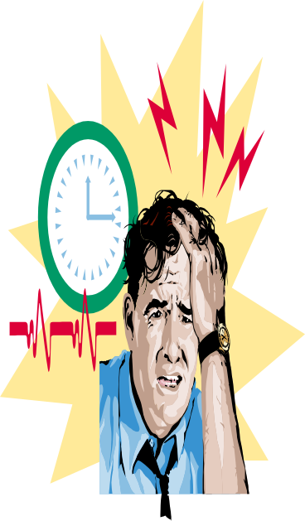
Work Stress and Its Management
Stress: A dynamic situation in which an individual is confronted with an opportunity, constraint, or demand related to what he or she desires and for which the outcome is perceived to be both uncertain and important.
An adaptive response to a challenging, threatening situation.

Slide 9
Four Basic Variations of Stress in Life
Overstress ( Hyperstress)
Bad Stress (Distress)
Good Stress (Eustress)
Stress
Downs
Depression
Termination
Divorce
Death
Ups
Jubilation
Promotion
Marriage
Birth
Understress ( Hypostress)
Notes:
Is all stress bad?
The negative stressor distress results from unpleasant encounters. Positive events also generate stress but in a pleasant manner, known as eustress. Then there is neutral stress which can result in distress or eustress depending on one’s perception and the way one deals with it. Overstress and understress refer to the intensity of stress and both are harmful to the optimum performance of an individual, here medium level of stress is desirable.

Slide 10
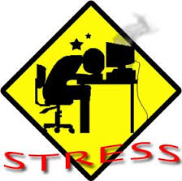
Overstress
Understress
Coping
Resources
Pressures
Mind
Body
Personality
Perception
Coping Resources Exceeding Pressures
Out of Control
(-) Hyper
Stress

Slide 11
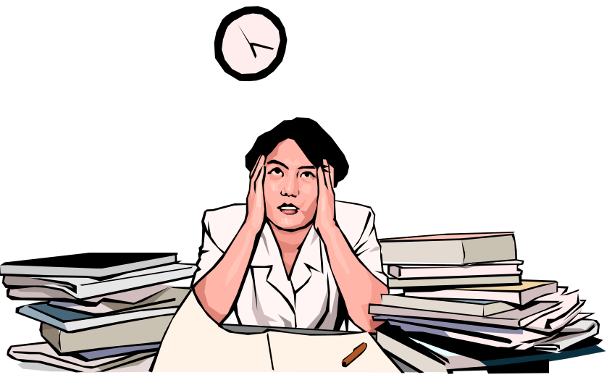
Work Stress and Its Management
Demands
The loss of something desired
Resources
Things within an individual’s control that can be used to cope with demands

Slide 12
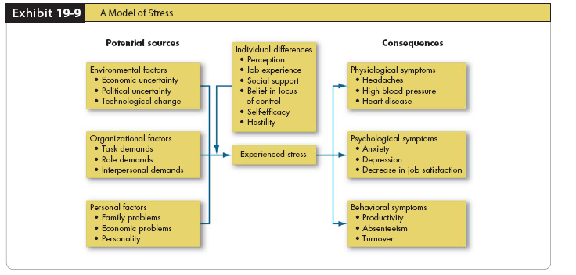
A Model of Stress

Slide 13
Emergence of Stress
Contemporary environment demands
  Technostress
Stress is, and is not
  Hindrance stressors
  Challenge stressors
  Job stress
  Stress is not:
    Simply anxiety
    Simply nervous tension
    Necessarily something damaging, bad, or to be avoided.
Burnout

Slide 14
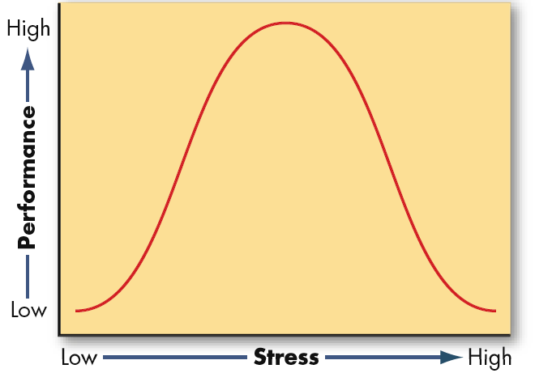
Inverted-U Relationship Between Stress and Job Performance

Slide 15
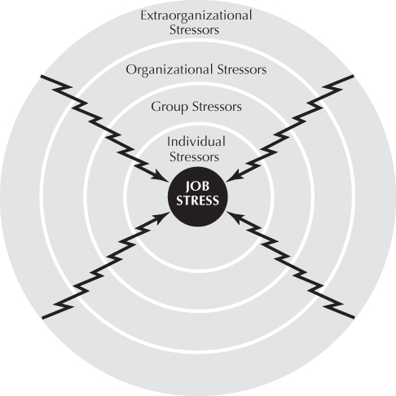
Causes of Stress
Categories affecting occupational stress

Slide 16
Causes of Stress
Continued
Extraorganizational stressors
  Societal/technological change
  Globalization
  Family, relocation, economic and financial conditions
  Sociological-demographic
  Residential or community conditions

Slide 17
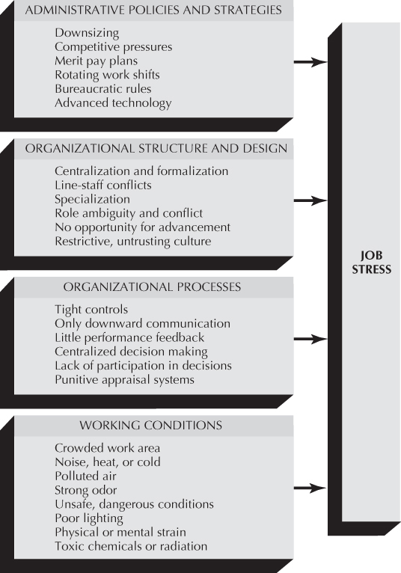
Causes of Stress
Continued

Slide 18
Causes of Stress
Continued
Group stressors
  Lack of group cohesiveness
  Lack of social support
Individual stressors: role of dispositions
  Type A characteristics
  Personal control
  Learned helplessness
  Psychological hardiness

Slide 19
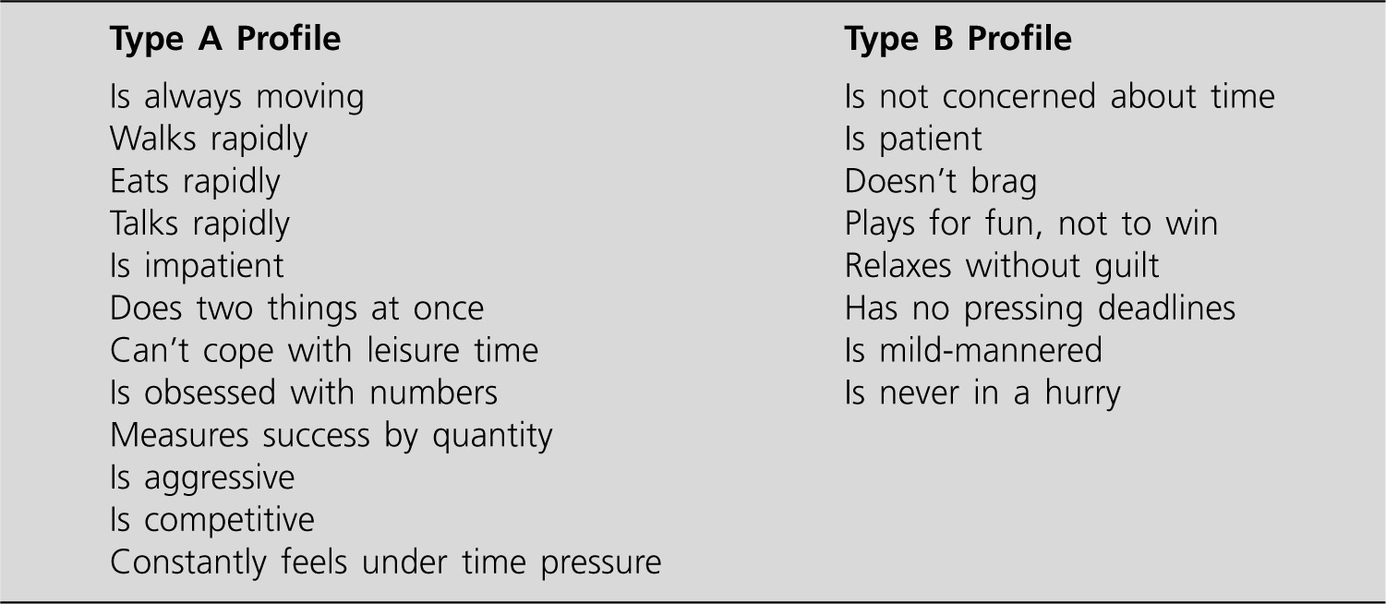
Causes of Stress
Continued
Individual stressors (continued)
  Type A characteristics

Slide 20
Effect of Stress
Physical problems
  Immune system problems
  Cardiovascular system problems
  Musculoskeletal system problems
  Gastrointestinal system problems
Psychological problems
  Anger, anxiety, depression, nervousness, irritability, tension, and boredom

Slide 21
Effect of Stress Continued
Behavioral problems
  Direct behaviors include under-eating or overeating, sleeplessness, increased smoking and drinking, and drug abuse.
  Decrease in productivity
  Absenteeism, job turnover

Slide 22
Coping Strategies for Stress
Individual coping strategies
  Exercise
  Relaxation
  Time Management
  Behavioral self-control
  Cognitive therapy
  Networking
Organizational coping strategies
  Reorganization initiatives
  Work and life benefit policies and programs

Slide 23
Coping Strategies for Stress
Organizational coping strategies (continued)
  Improved personnel selection and job placement
  Training
  Use of realistic goal setting
  Redesigning of jobs
  Increased employee involvement
  Improved organizational communication
  Establishment of corporate wellness programs
  In case of downsizing:
    Be proactive
    Acknowledge survivors’ emotions
    Communicate after the downsizing
    Clarify new roles

